Slide 1

ScanMasterX Team No 10: UwUltimate Stardust Crusaders

Slide 2





Team Details
Eric
Lewis
Dennis
Alexa
Will

Slide 3
Project Overview
Problem: The Rising Cost Of Cybersecurity Breaches
Average Data Breach Cost: $4.45 million (Forbes)
Projected Cybercrime Damages: Over $10 Trillion by 2025 (Forbes)
Our Solution: ScanMasterX

Slide 4
Vision
Lower The barrier to scan and analyze complex networks
Prevent Data Breaches by identifying vulnerable services
Perform Automated Security Testing
Display the Topology and Security Score

Slide 5
Requirements List
There must be a feature to identify vulnerabilities on a server.
There must be a component that will evaluate the security of a given server.
The user must be able to select which device(s), which ports, or which group of ports, that they wish to test and scan.

Slide 6

Project Solution Approach
Major Components
Custom scanner leveraging Nmap
GUI for user to interact with
Tools, Frameworks, Platforms, Libraries
PYQT - UI framework for Python
NMAP – A CLI network scanner
CVE Database [TBD]

Slide 7
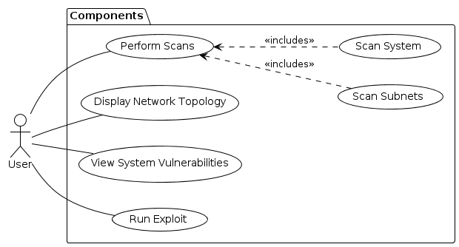
Use Case Modeling

Slide 8
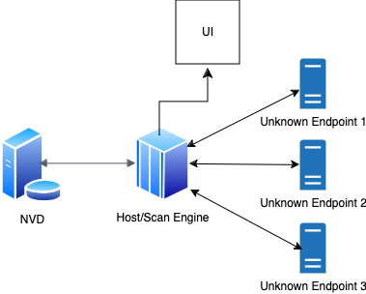
System Architecture Diagram

Slide 9
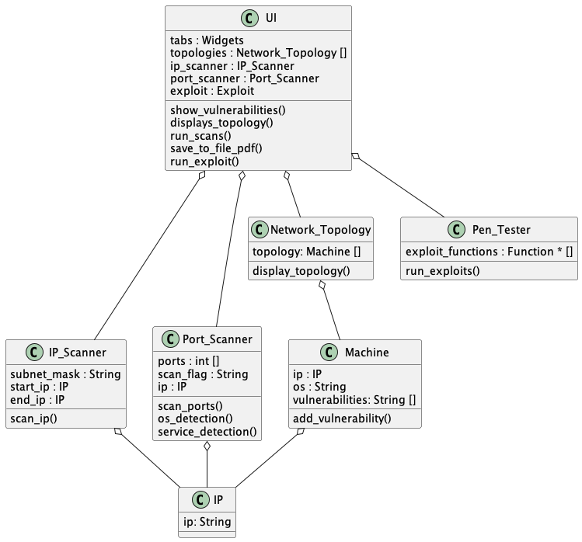
Structural Modeling: Class Diagram

Slide 10
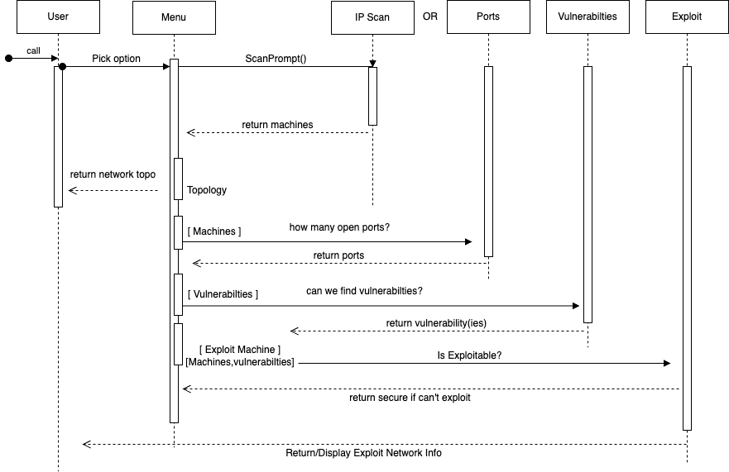
Behavioral Modeling: Sequence Diagram

Slide 11
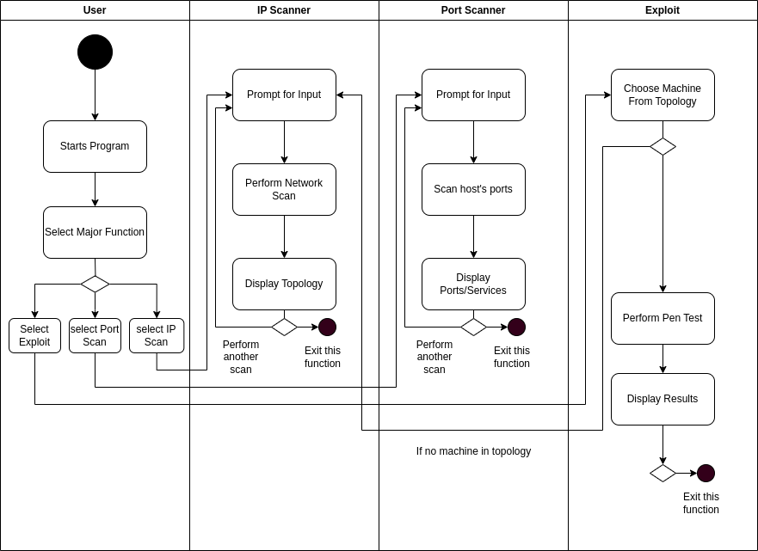
Behavioral Modeling: Activity Diagram

Slide 12
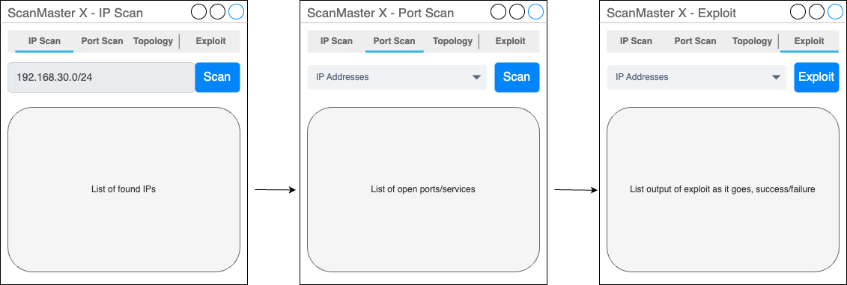
UI

Slide 13
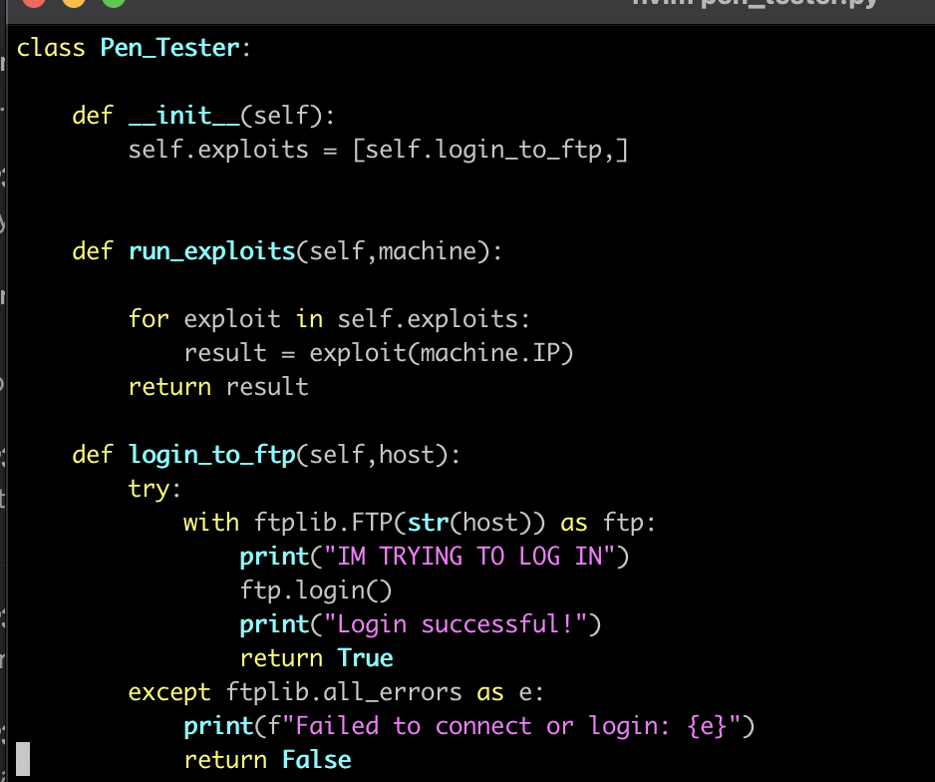
Demo Time on Exploits!

Slide 14

What’s Next??
Development of the UI
Displaying the Topology
Identifying Vulnerabilities

